Slide 1






PRESENTATION 2026
Social Media Engagement Analysis
Mentor Name
Student Name
Student Email
Umamaheswari
Amreen Shaikh
shaikhamreen731@gmail.com

Slide 2

Outline
Abstract of the Project
Problem Statement
Proposed Solution
System Architecture
Live Demo of the Project
Embedded Video of Project
Conclusion
Future Scope

Slide 3
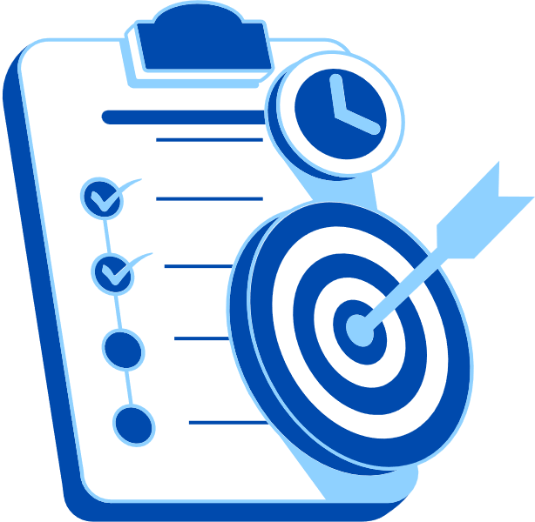
Abstract
This project focuses on analyzing social media engagement patterns across platforms such as Instagram, Twitter, and LinkedIn.
The objective is to identify what type of content drives higher engagement (likes, shares, comments) and how posting frequency, timing, and hashtags influence audience interaction.
Tools like Python, Power BI, and Copilot are used for data collection, visualization, and insights.
The expected outcome is a framework that helps brands and individuals optimize their social media strategies.

Slide 4

Problem Statement
Social media platforms generate massive amounts of data daily, but most users and organizations struggle to understand what truly drives engagement.
Existing analytics tools often provide surface-level metrics without deeper insights into content performance trends.
This project addresses the challenge of extracting actionable insights from raw engagement data to improve content strategy and audience reach.

Slide 5

Proposed Solution
The solution involves building a data pipeline that collects engagement metrics via KPIs (likes, shares, comments, impressions).
Data is cleaned and analyzed and visualized in Power BI dashboards.
AI-driven sentiment analysis is integrated to understand audience reactions.
Compared to traditional analytics, this solution provides deeper insights into engagement drivers, helping optimize posting strategies.

Slide 6
System Architecture
Data Input / Source
Processing / Analysis
KPIs from Instagram, Twitter, LinkedIn, exports, Data Input Kaggle, Chatgpt scraped datasets.
Data cleaning in Excel Data transformation in Power BI Creating measures like : Total Engagement = Likes + Comments + Shares Engagement Rate
AI / Tool Integration
Output / Dashboard
Power BI for visualization Excel for data handling Copilot for insights and suggestions.
Interactive dashboard showing engagement trends, best posting times, content type performance.

Slide 7
Live Demo of Project
Here's the list of some demo screenshots / features of the project:
Demo 1
Demo 2
Demo 3
[Add description of Demo 1 here — what this demo shows, key features, and results achieved.]
[Add description of Demo 2 here — what this demo shows, key features, and results achieved.]
[Add description of Demo 3 here — what this demo shows, key features, and results achieved.]

Slide 8
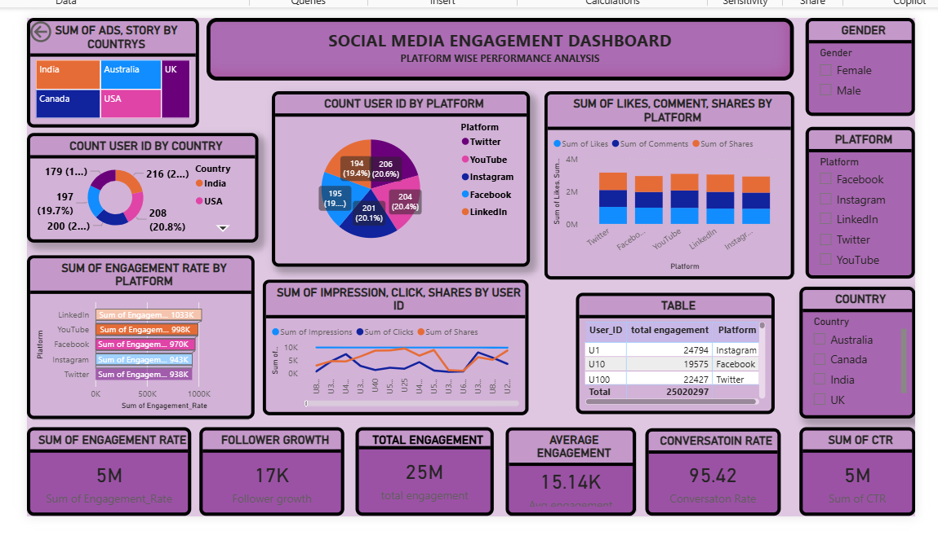
Video of Project Demo
[https://your-project-demo-link.com]
▶
[Insert your project demo video.
You can embed a video your live project.]

Slide 9

Conclusion
The project successfully demonstrates how AI and analytics can uncover hidden patterns in social media engagement. By identifying optimal posting strategies and content types, the solution adds value to digital marketing efforts and personal branding.
CONCLUSION

Slide 10
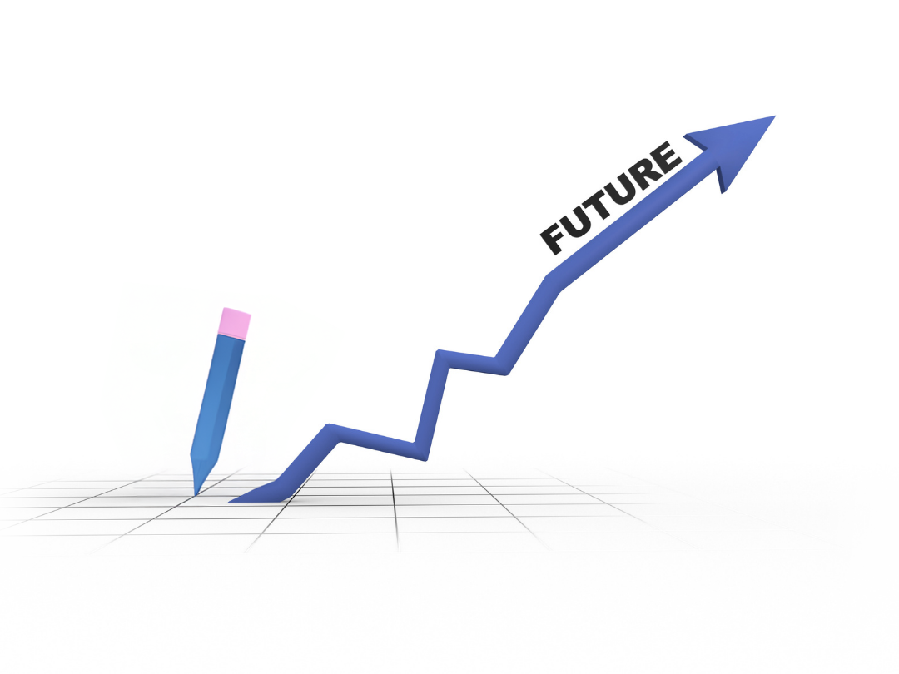
Future Scope
Expand analysis to Instagram and YouTube.
Integrate predictive modeling to forecast engagement.
Automate recommendations for hashtags and captions.
Explore cross-platform engagement correlations

Slide 11
Thank You
AICW Fellowship | Student Project Presentation 2026
LinkedIn | Edunet Foundation

